Slide 1

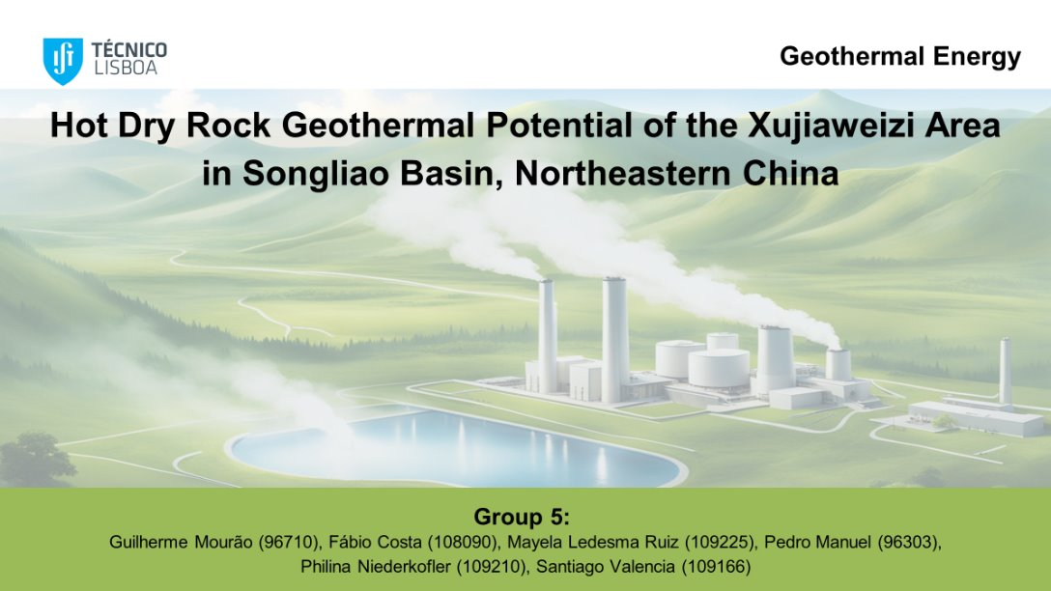
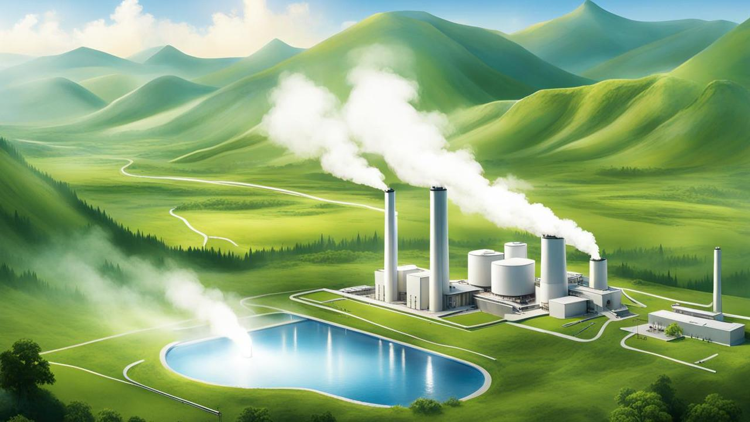
Geothermal Energy
Hot Dry Rock Geothermal Potential of the Xujiaweizi Area in Songliao Basin, Northeastern China
Group 5:
Guilherme Mourão (96710)
Fábio Costa (108090)
Mayela Ledesma Ruiz (109225)
Pedro Manuel (96303)
Philina Niederkofler (109210)
Santiago Valencia (109166)

Slide 2
Agenda
Type of Power plant (EGS design/technology)
Heating + Electricity conditions
Electric Power, efficiency and Parameters

Slide 3
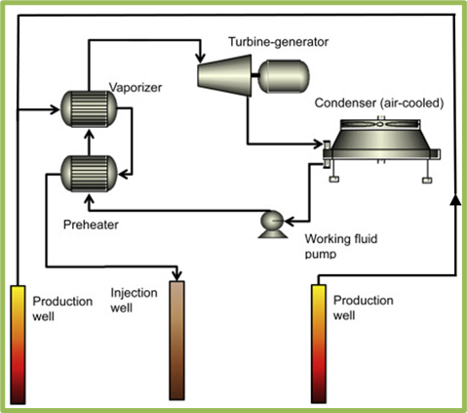

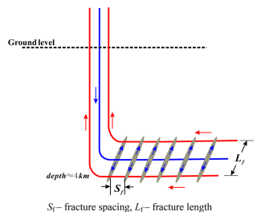


Power Plant
ORC (Organic Rankine Cycle) Binary system
Schematic diagram and side view of heat extraction well
(Guo et al., 2016)

Slide 4
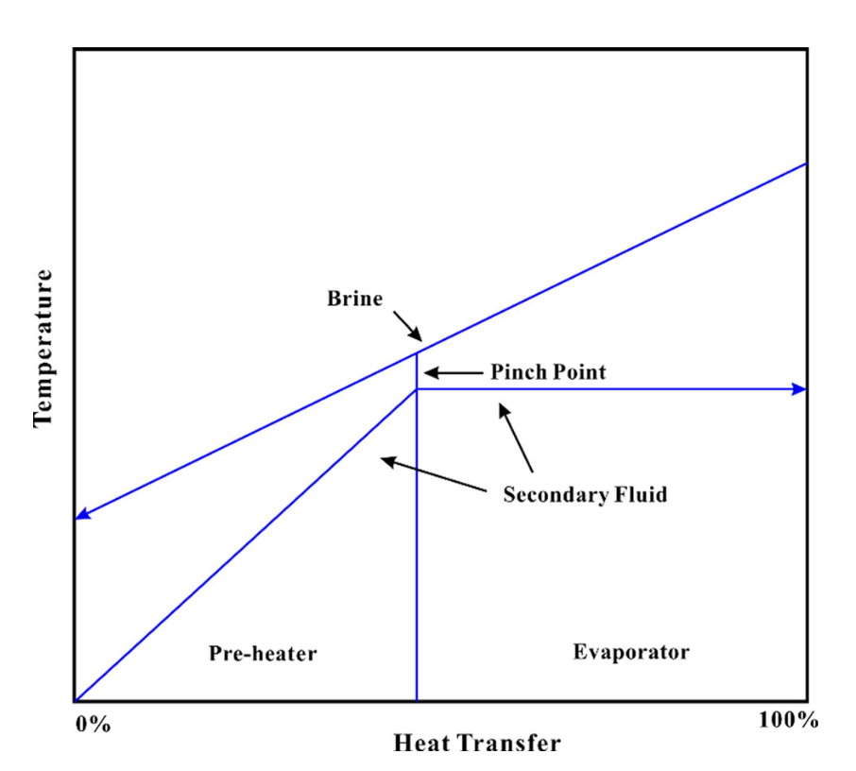
Development of a geothermal plant
Criteria for hydrothermal stimultaion
Bottom-hole injection pressure < P_{inj} minimum principle stress, sigma min
Thats how the maximum production flow rate can be determined
choice of reference temperature > pinch point temperature

Slide 5
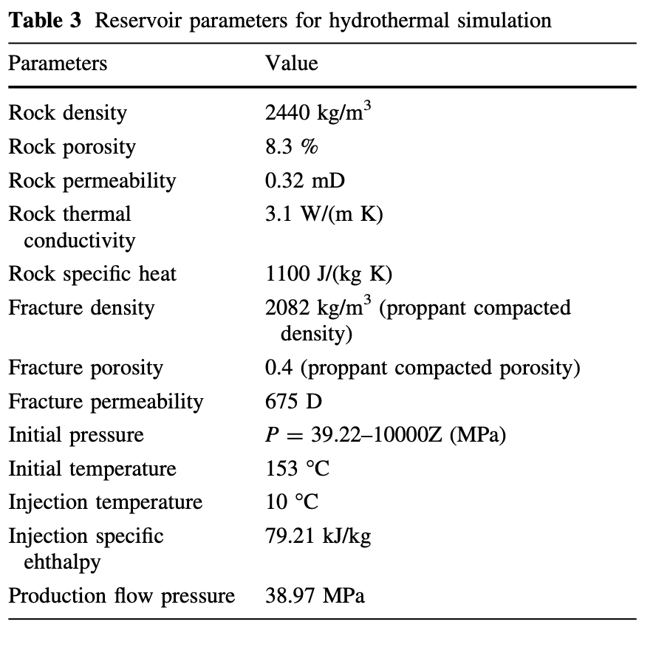
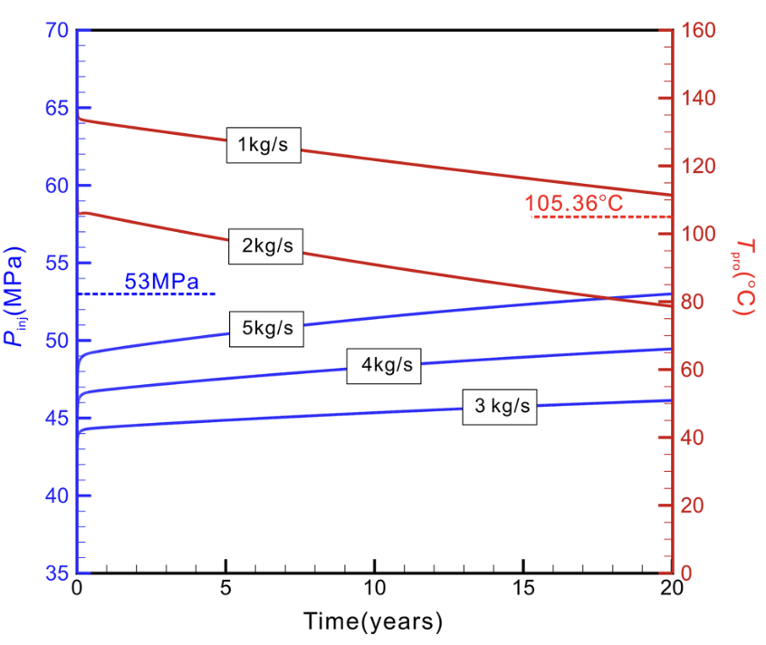
Hydrothermal stimulation

Slide 6
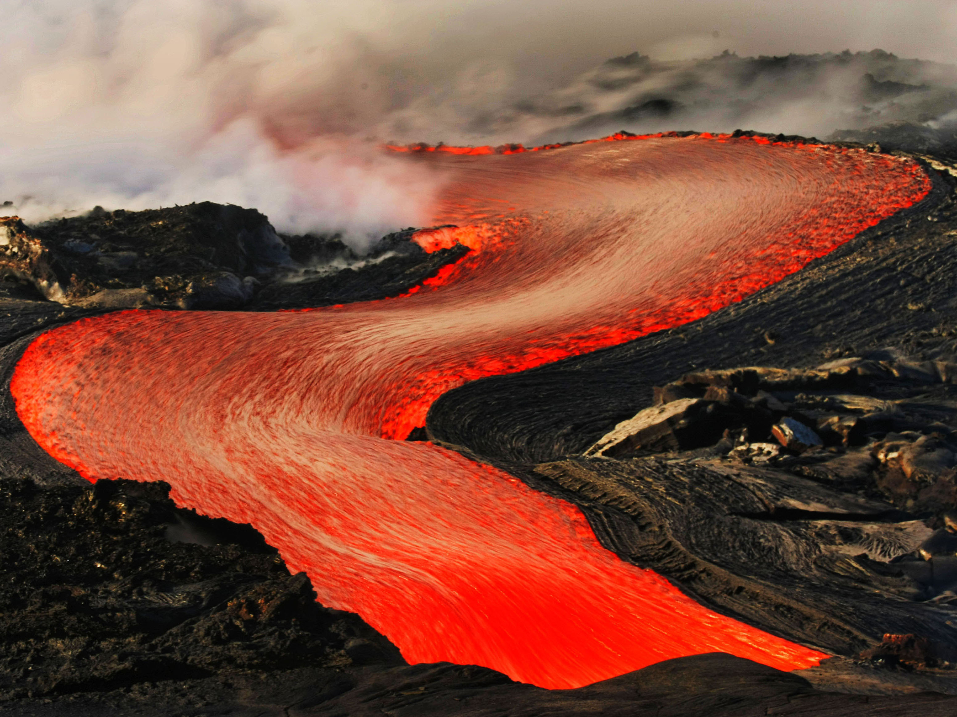


Efficiency
Heat
Electrical Power
Optimal Scenario:
For heating, the best approach is an injection rate of 5 kg/s in the given scenario.
Heat Production:
Ranging 0.80 - 1.35 MW over the same 20-year period, with a flow resistance of 2.8 MPa/(kg/s).
Implications:
This shows the significant potential for heating applications, especially for residential and industrial uses in the region.
Overview:
The optimal electricity generation in the EGS project involves using an injection rate of 1 kg/s.
Power Output:
Over a 20-year period, the electrical power generation is estimated to be between 0.014 and 0.028 MW.
Parameters:
Maximum electrical power (We);
flow resistance (IR) of 5.1 MPa/(kg/s) .
≈ 7%
Notes:
- Figure 22 (Temperature Distribution on Fracture Plane): Visualizes the temperature drop within the reservoir, crucial for assessing thermal recovery rates and system efficiency.

Slide 7
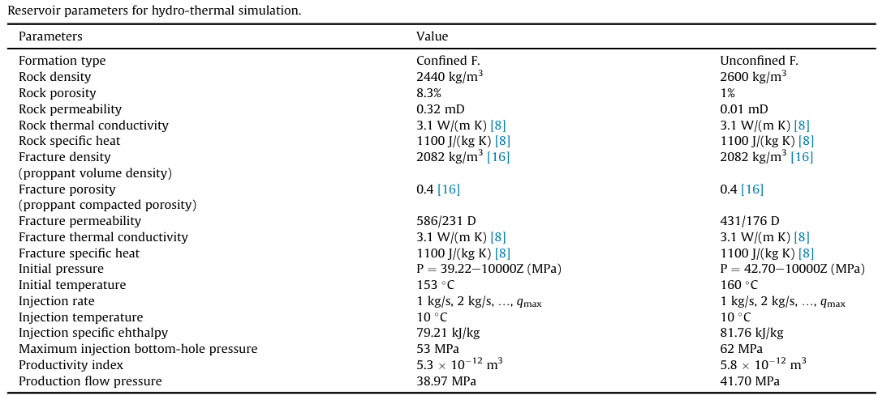
Electrical Production Parameters
Reservoir Parameters:
Rock density (2440 kg/m³)
Rock porosity (8.3%)
Rock permeability (0.32 mD)
Fracture Parameters:
Injection temperature is set at 10°C, maximum injection bottom-hole pressure of 53 MPa.
Production Water Temperature (T_{pro}):
Critical variable, influencing the overall efficiency and longevity of the power plant.
Initial T - 153°C (confined formation)
-160°C (unconfined formation)
Production water T - starting at 140°C and 126°C, respectively.
(Guo et al., 2016)
Notes:
- Figure 22 (Temperature Distribution on Fracture Plane): Visualizes the temperature drop within the reservoir, crucial for assessing thermal recovery rates and system efficiency.

Slide 8
References
Guo, L., Zhang, Y., Yu, Z., Hu, Z., Chengyu, L., & Xu, T. (2016). Hot dry rock geothermal potential of the Xujiaweizi area in Songliao Basin, northeastern China. Environmental Earth Sciences, 75(6). https://doi.org/10.1007/s12665-016-5327-9
Huang, X., Zhu, J., Niu, C., Li, J., Hu, X., & Jin, X. (2014, October). Heat extraction and power production forecast of a prospective Enhanced Geothermal System site in Songliao Basin, China. Energy, 75, 360–370. https://doi.org/10.1016/j.energy.2014.07.085

Slide 9

Thank you for
your attention!

